Slide 1
Predicting Company Responses to Complaints
Joel Ponder
Lawrence Amadi
Shringa Bais
Swapnil Gaikwad

Slide 2
GOAL
Predict Company Response Labels
Closed with Explanation
Closed with Monetary Relief
Closed with Non-monetary Relief
Closed
Closed with Relief
Closed with Non-relief
In Progress
Application and Relevance
User Case 1
Consumer feels out complaint on CFPB website
Run model in real time and predict the type of response
Consumer adjusts complaint to get desired response
User Case 2
Regulator would like to see if companies are acting in good faith
Predict company responses to complaints
Compare actual company responses to predicted
Flag company for review if there is consistent discrepancy

Slide 3
DATA
Consumer Financial Protection Bureau (CFPB) gathers thousands of consumer complaints about financial products. Those complaints are published here after the company responds within 15 days.
743,532 Total Records
134,855 of the records have “Consumer Complaint Narrative” (> 20%)
553,421 are “Closed with explanation” (75%)
49,610 are “Closed with monetary relief”
92,111 are “Closed with non-monetary relief”
5,298 are “Closed with relied”
17,863 are “Closed without relief”
18 Features in .csv Spreadsheet
Date received
Product
Sub product
Issue
Sub issue
Consumer complaint narrative [Text]
Company
State
Zip code
Company response to consumer [Class]
Approaches
Decision trees for filtering
Text preprocessing
TF-IDF Vectorizer
Naïve Bayes Classifiers & Others
Cosine Similarity
LSA & SVD Dimensionality Reduction
Confusion Matrix

Slide 4
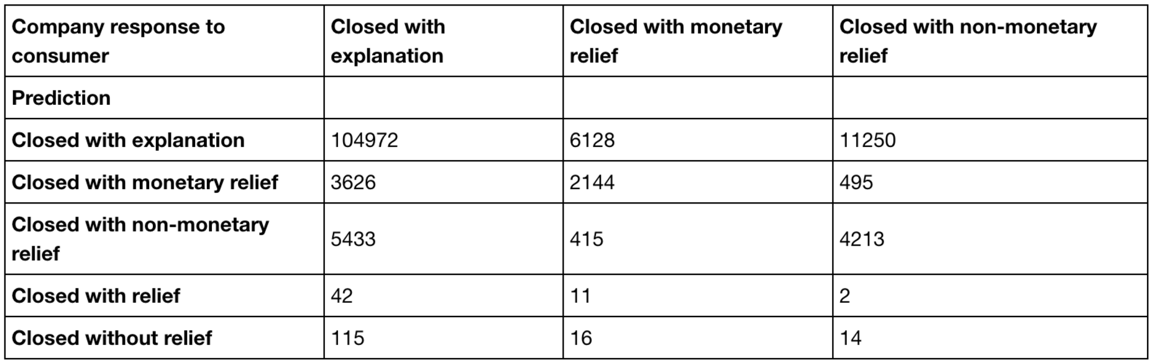
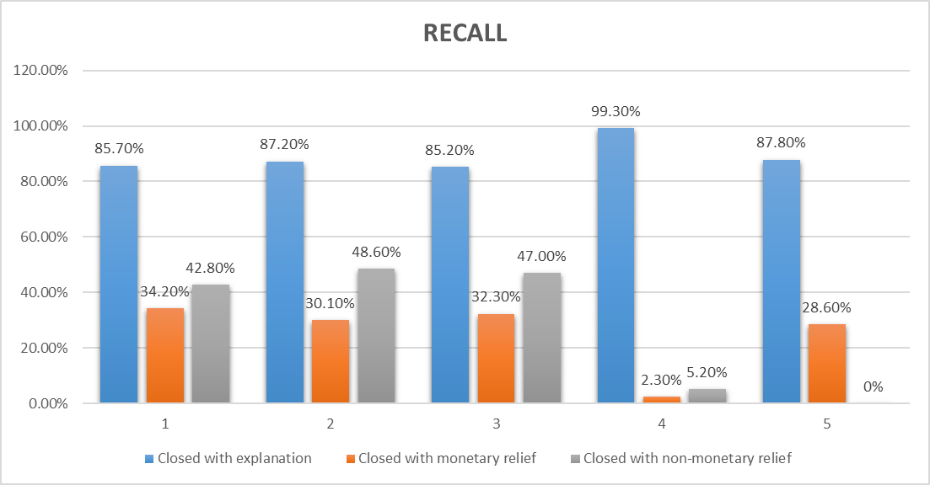
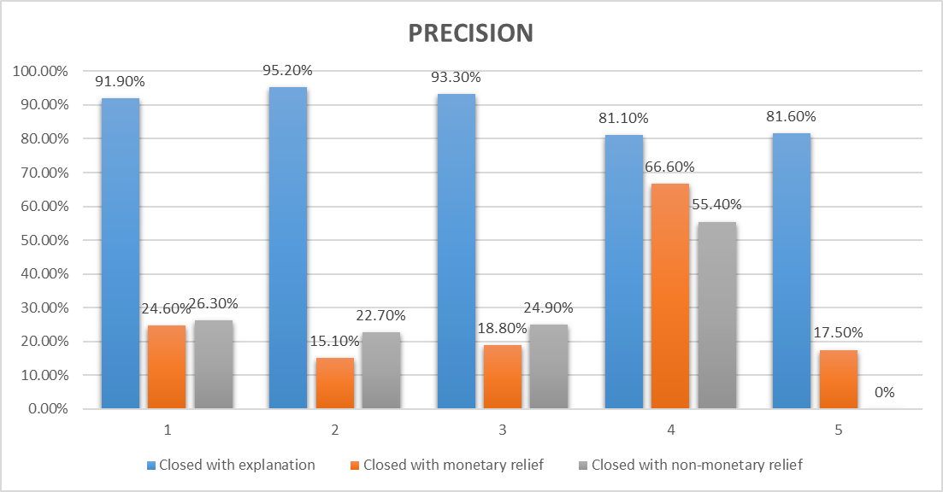
EXPERIMENTS & RESULTS
EXP 1: Secondary Prediction with Category Breakdown
EXP 2: Secondary Prediction with no Category Breakdown
EXP 3: Decision Tree Predictions
EXP 4: Random Forest Classifier
EXP5: Multinomial Naïve Bayes Classifier

Slide 5
CONCLUSION
What we learned:
Learned to apply Data mining concepts on real world data and how it should be handled
When doing supervised learning make sure you know the distribution of your classifiers. The distribution can create problems.
We could improve our precision in predictions. Two multiple rounds of prediction may be a viable choice.
Our Analysis:
We would like to have had more examples from “Closed with Monetary Relief” and “Closed with Non-Monetary Relief”.
Response to the Complaint may be a result of information from the Company's own data set that we do not have access to. It may not be possible to consistently predict these results.
Multiple approaches have been opted by our team to analyse the data and we cannot say any of them is not useful, from each analysis we have got information about the data and categorization.

